Slide 1
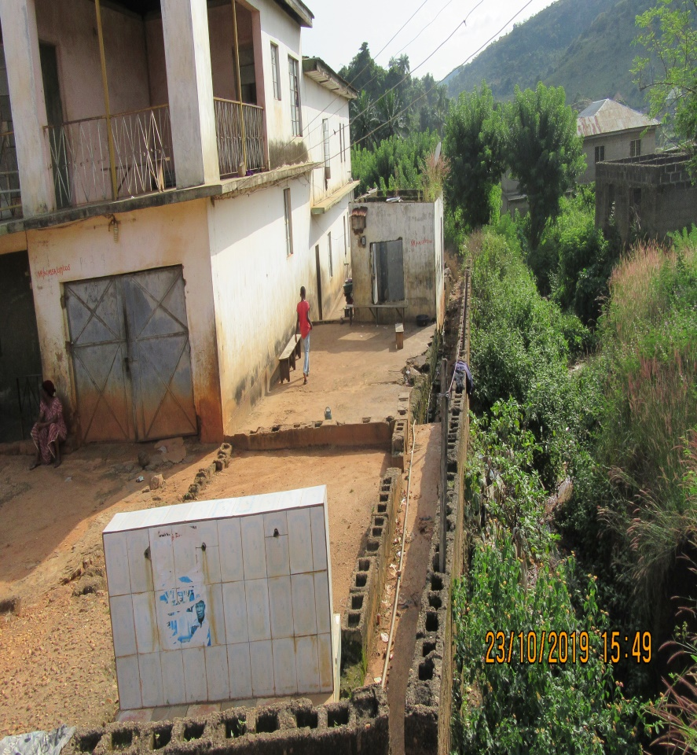
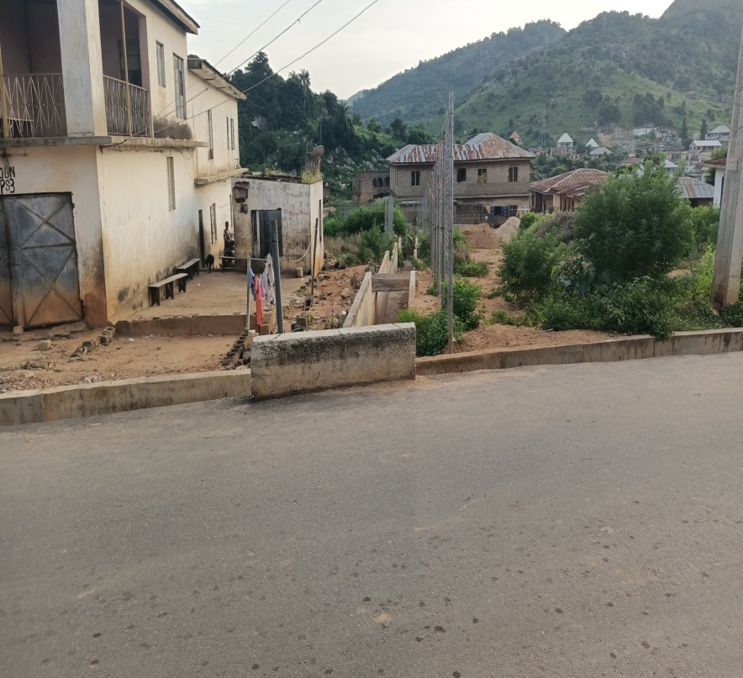
UPDATE ON CIVIL WORKS… DRAINAGE CONSTRUCTION WORKS AT AGASSA GULLY EROSION SITE
BEFORE…
AFTER…

Slide 2
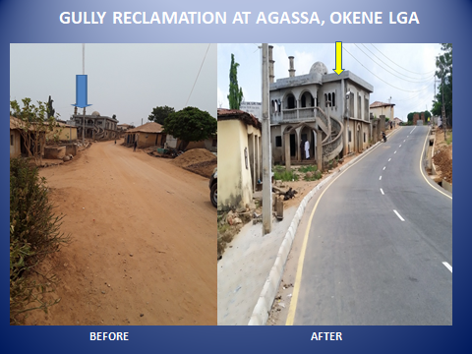
UPDATE ON CIVIL WORKS… DRAINAGE CONSTRUCTION WORKS AT AGASSA GULLY EROSION SITE
BEFORE…
AFTER…

Slide 3
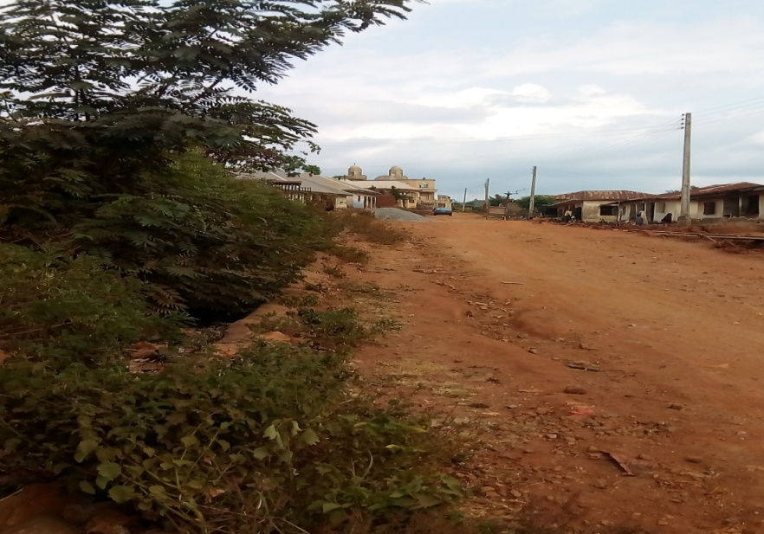
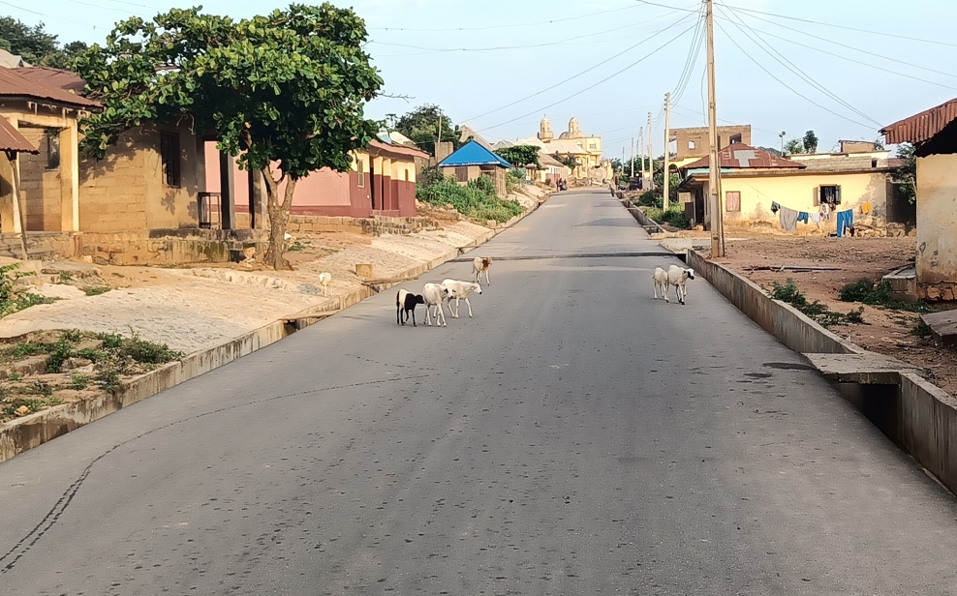
GULLY RECLAMATION AT AGASSA, OKENE LGA
AHACHE ROAD
BEFORE AFTER

Slide 4
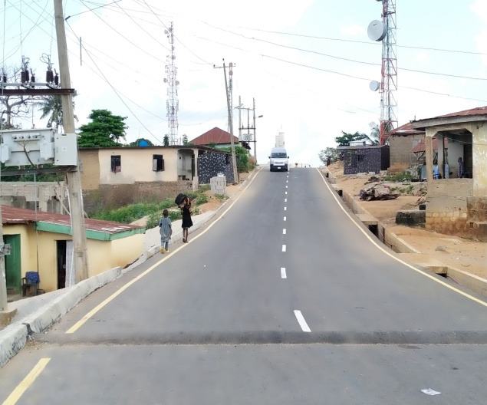
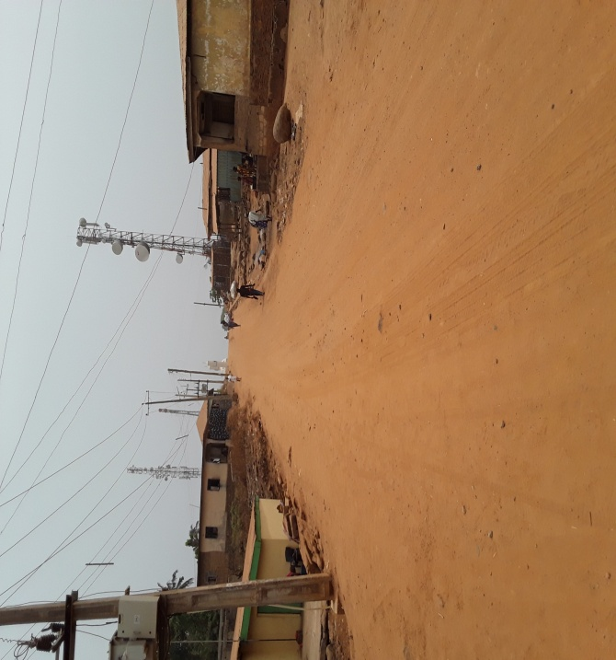
GULLY RECLAMATION AT AGASSA, OKENE LGA
OKENEBA ROAD
BEFORE AFTER

Slide 5
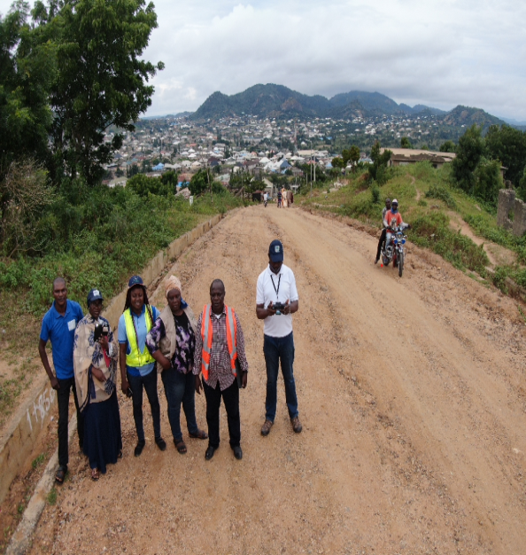
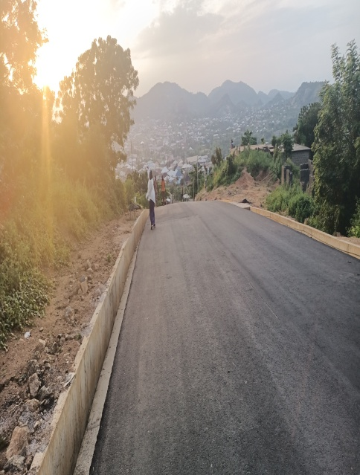
GULLY RECLAMATION AT AGASSA, OKENE LGA
OKENEBA ROAD
BEFORE AFTER

Slide 6
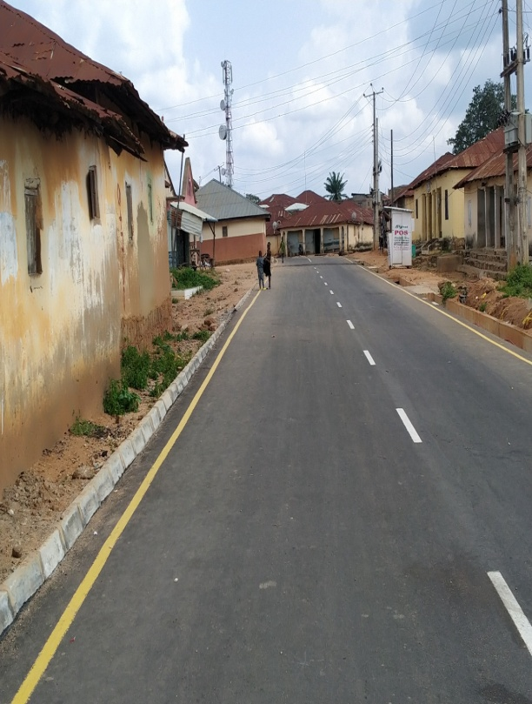
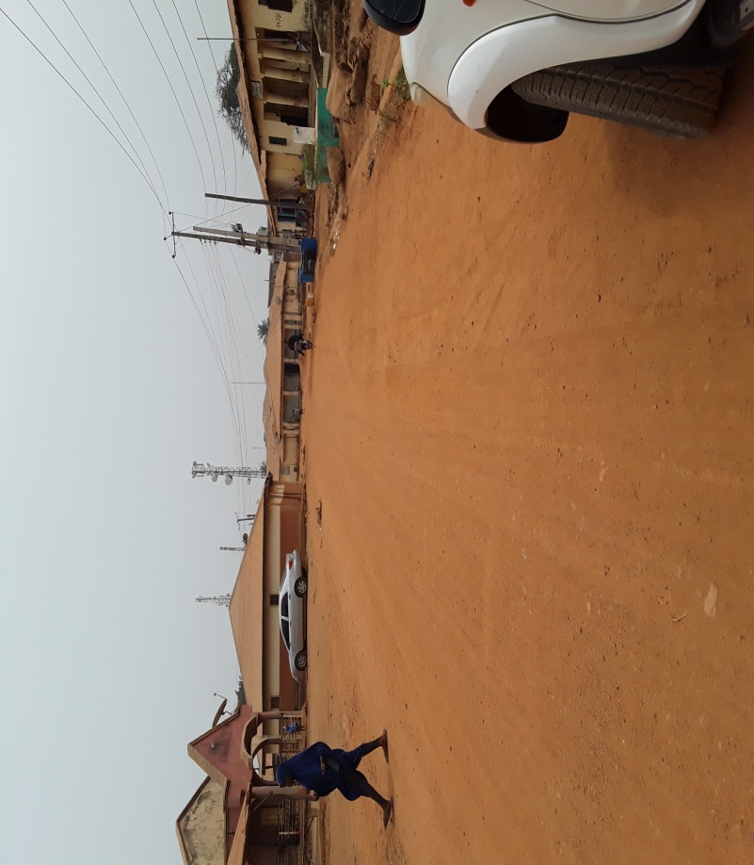
GULLY RECLAMATION AT AGASSA, OKENE LGA
OKENEBA ROAD
BEFORE AFTER

Slide 7
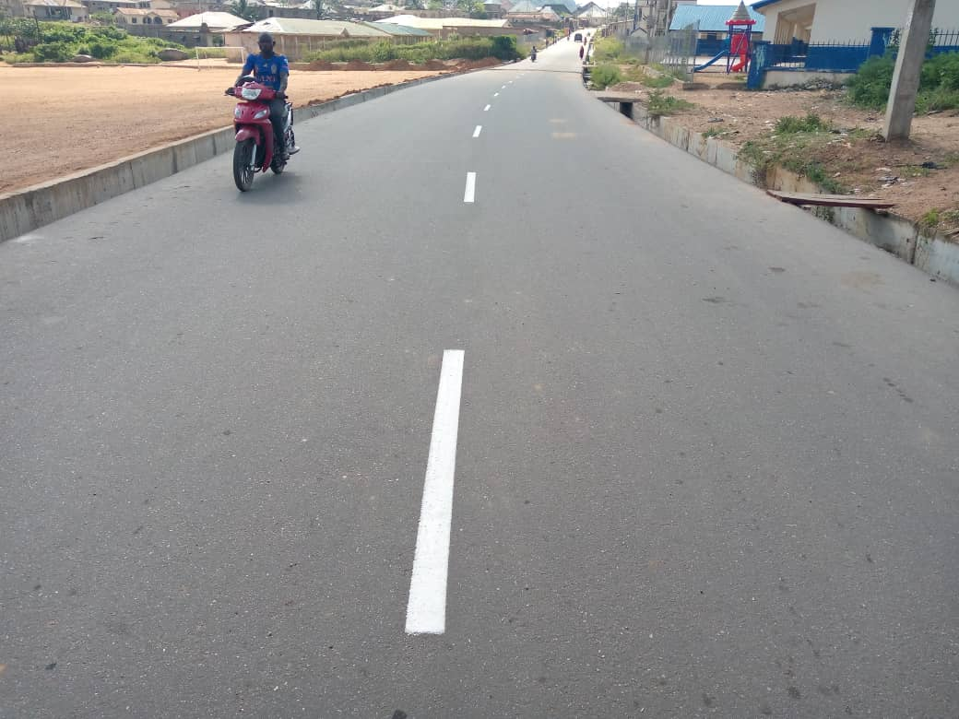
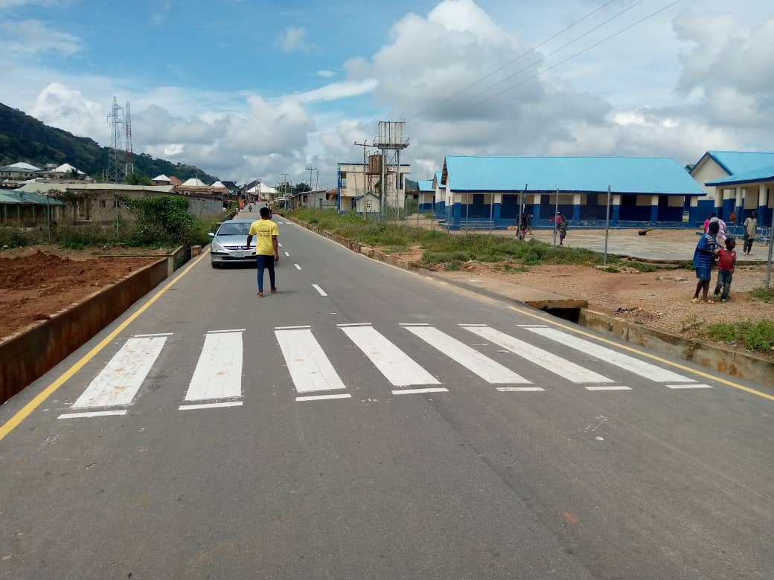
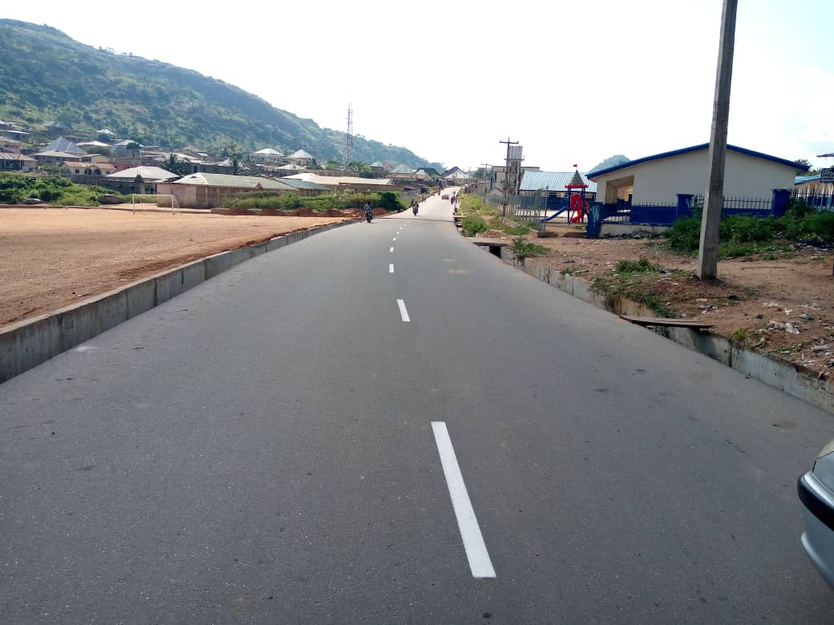
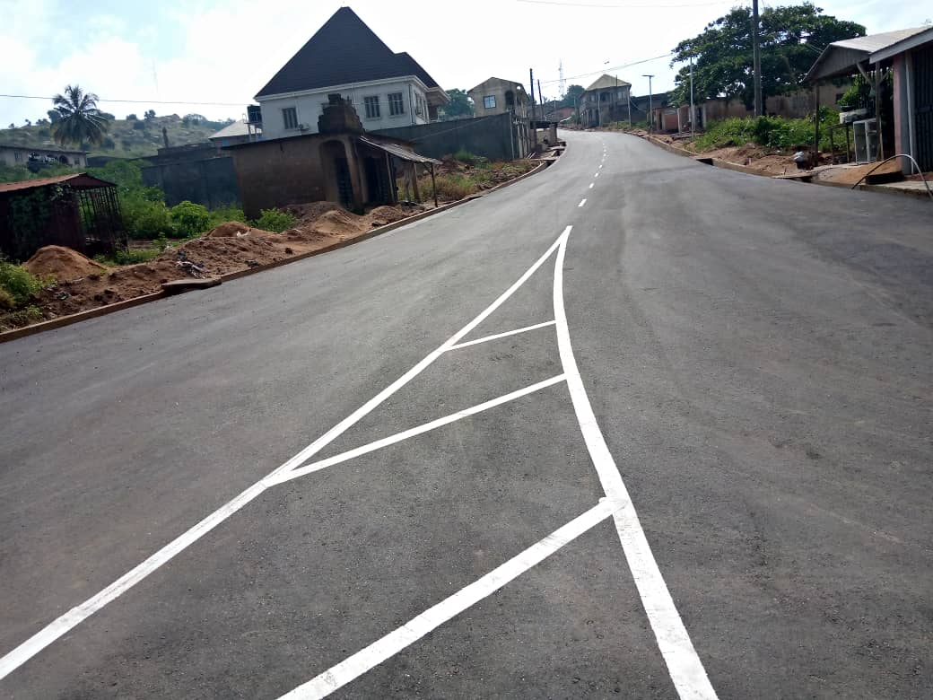

Slide 8
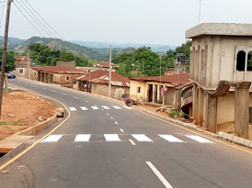
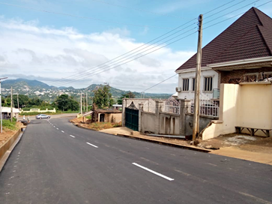
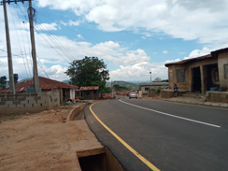
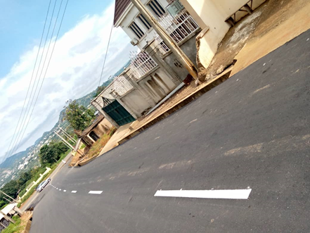
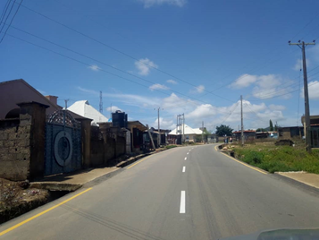

Slide 9
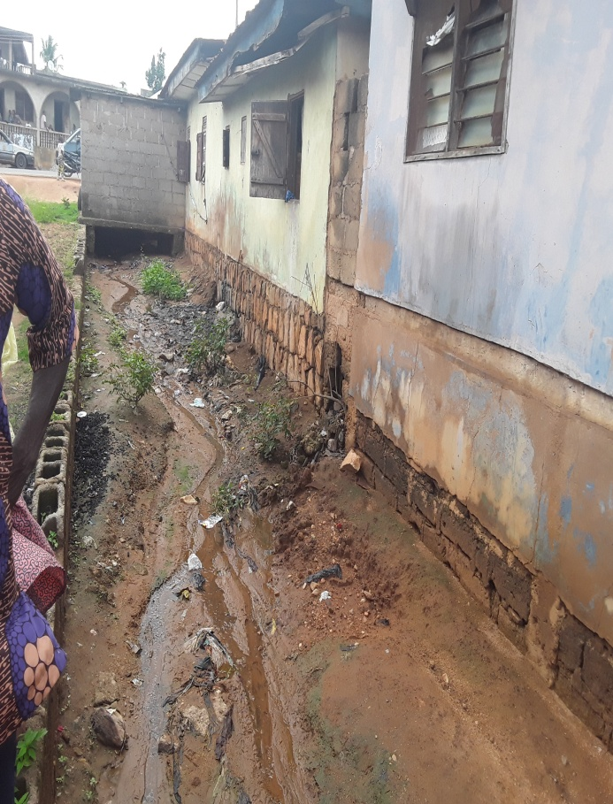
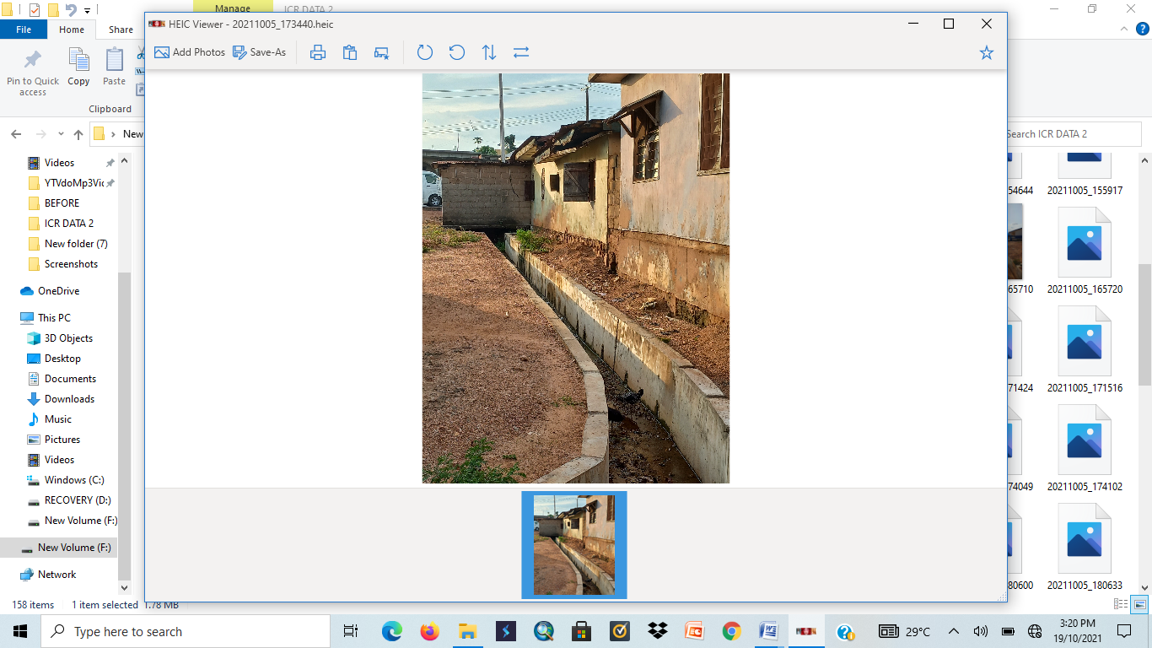
GULLY RECLAMATION AT AGASSA, OKENE LGA
GULLY
BEFORE AFTER

Slide 10
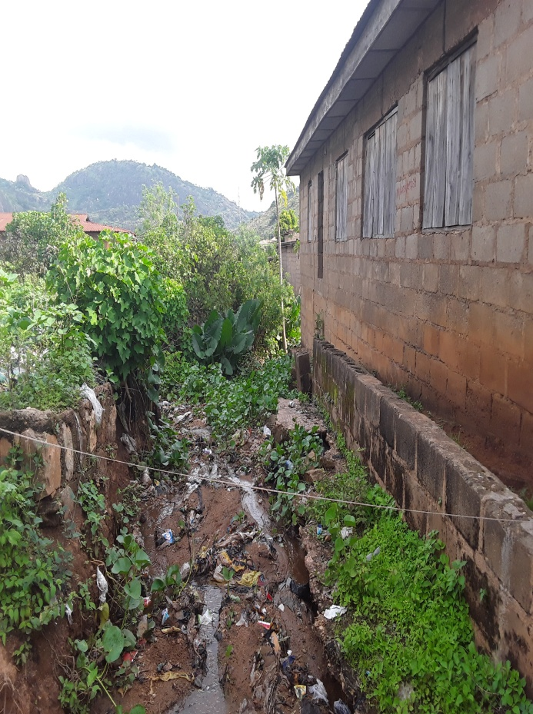
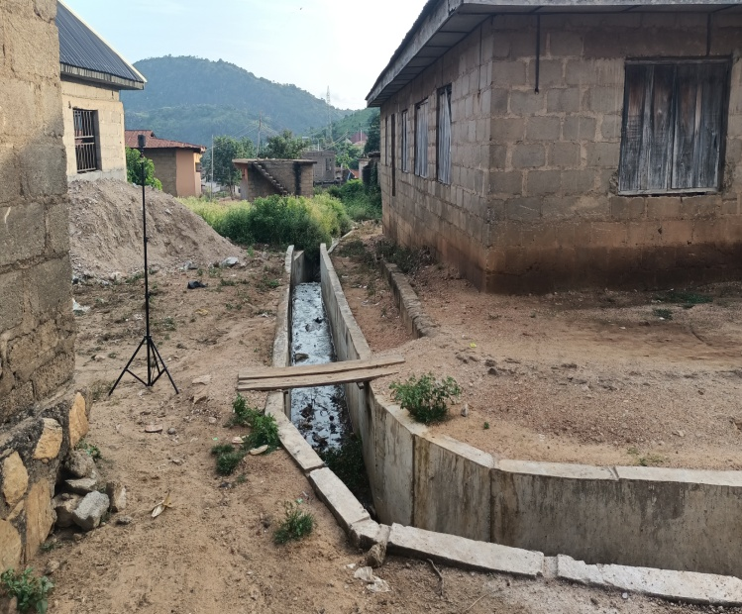
GULLY RECLAMATION AT AGASSA, OKENE LGA
GULLY
BEFORE AFTER

Slide 11
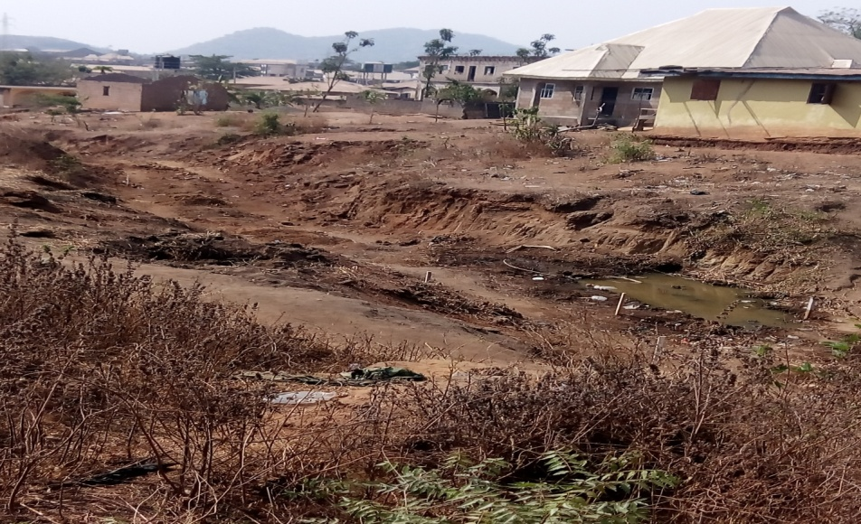
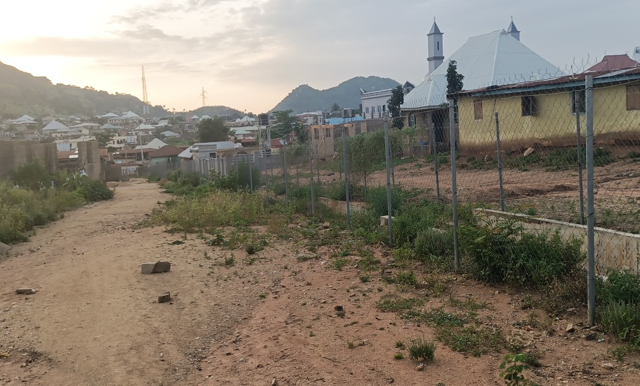
GULLY RECLAMATION AT AGASSA, OKENE LGA
GULLY 04
BEFORE AFTER

Slide 12
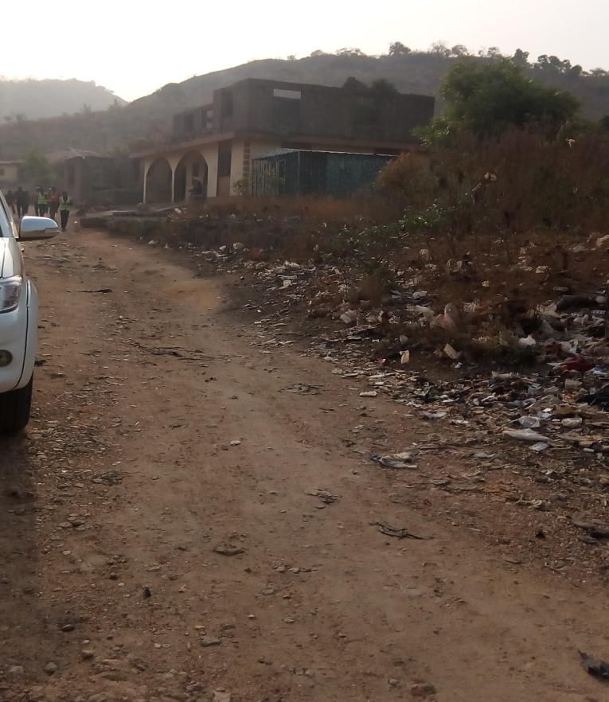
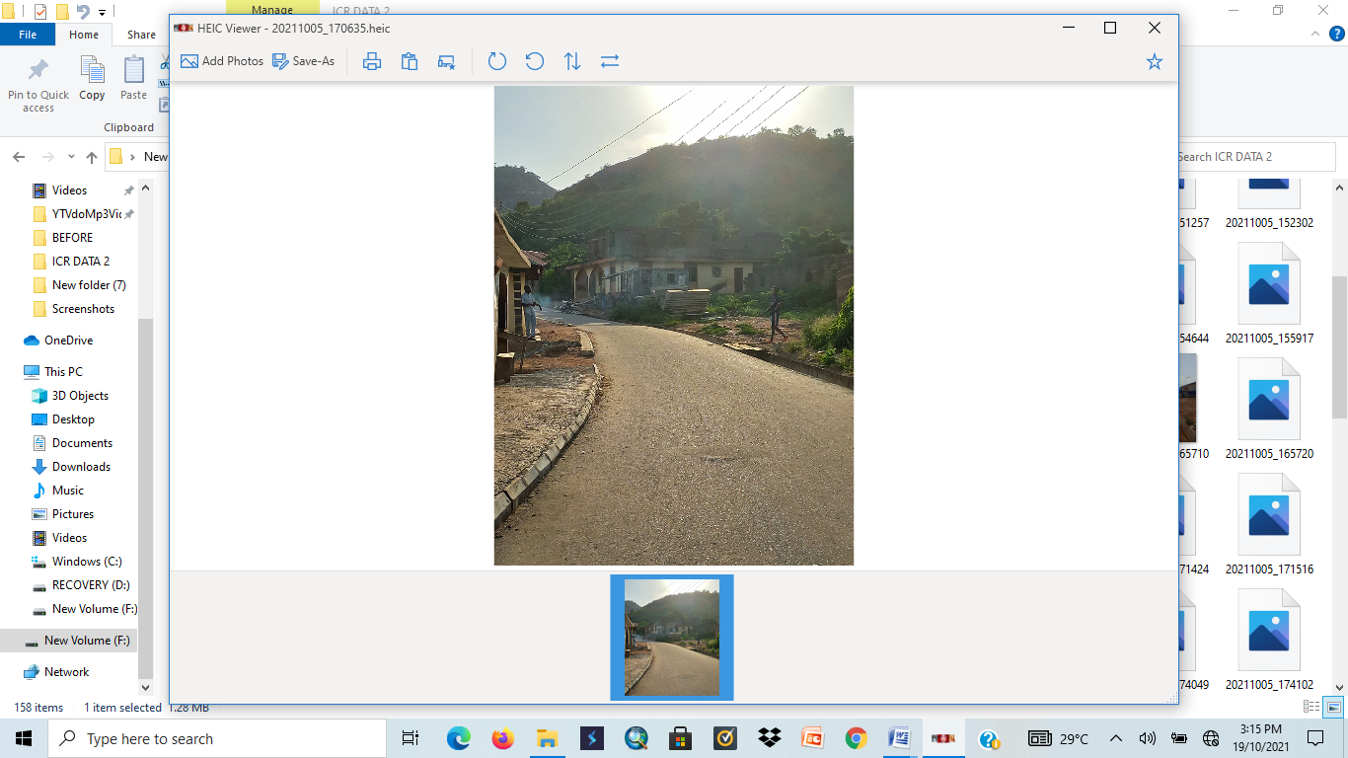
GULLY RECLAMATION AT AGASSA, OKENE LGA
ROAD 09
BEFORE AFTER

Slide 13
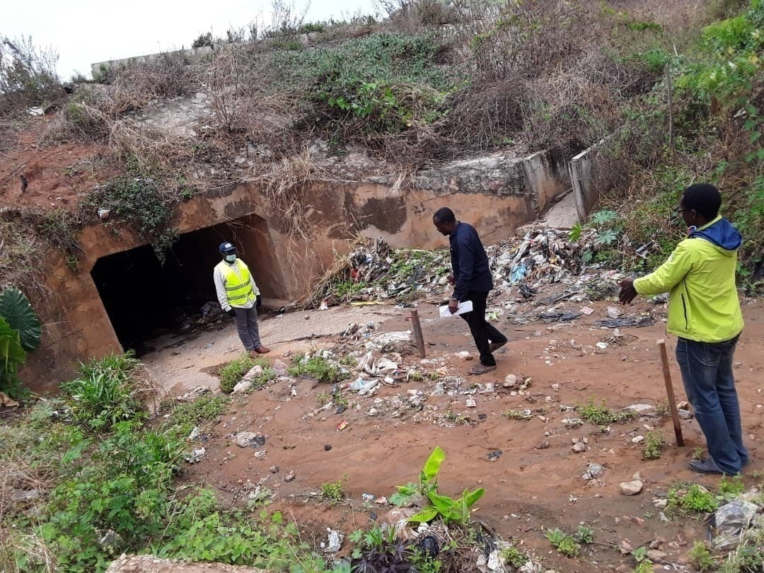
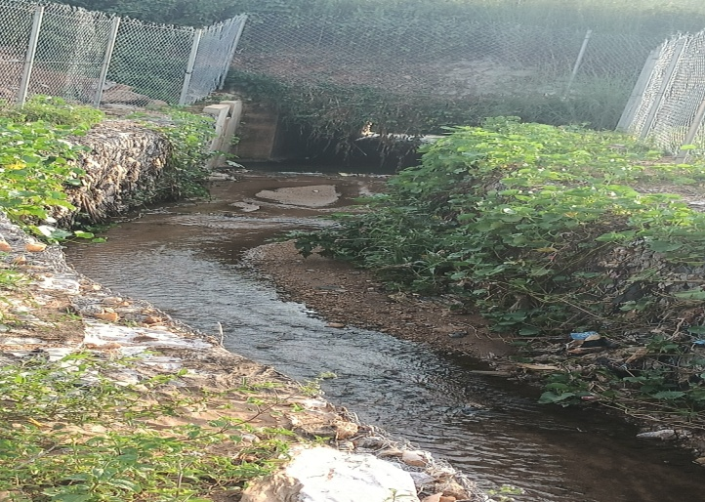
Update on Civil Works…
Gabion works at Agassa Gully Erosion Site
BEFORE…
AFTER…

Slide 14
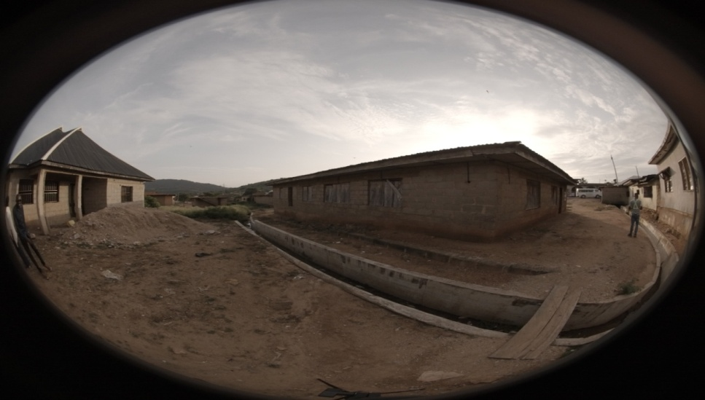
UPDATE ON CIVIL WORKS… DRAINAGE CONSTRUCTION WORKS AT AGASSA GULLY EROSION SITE
BEFORE…
AFTER…

Slide 15
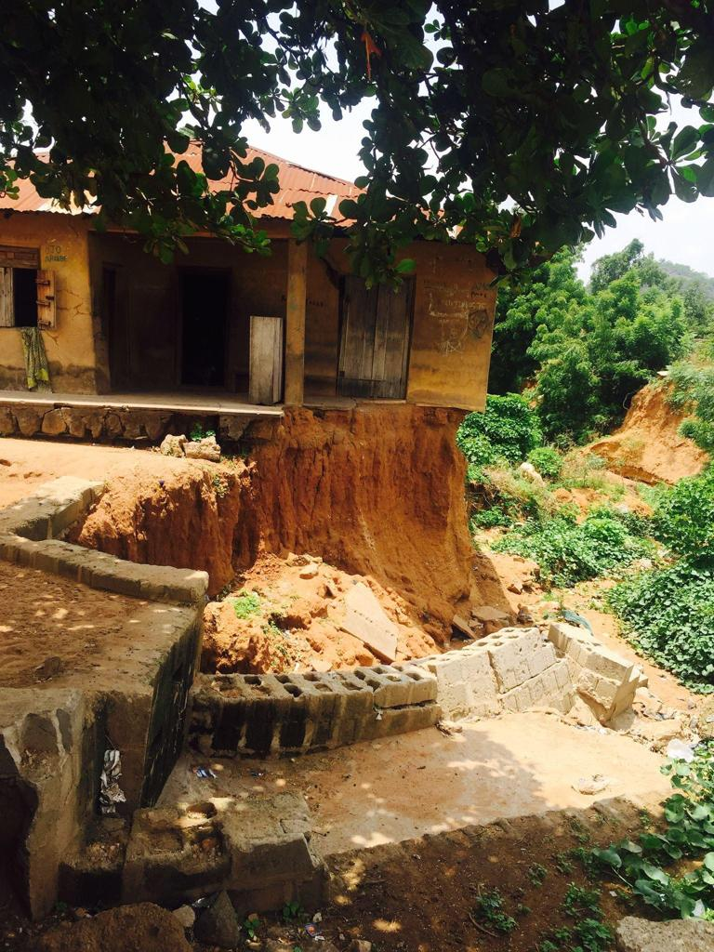
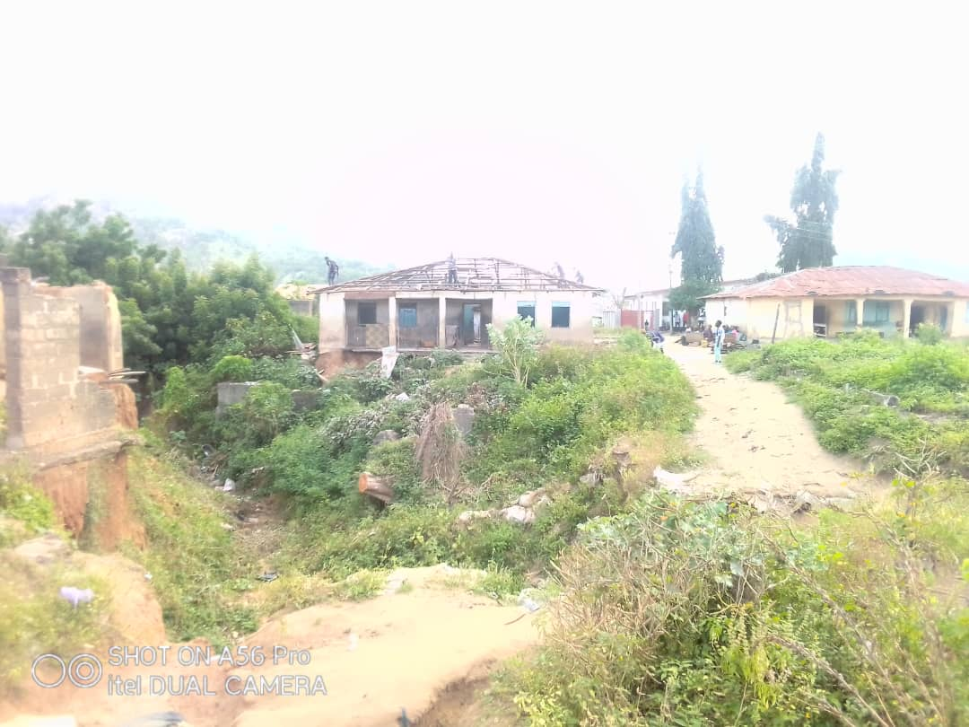
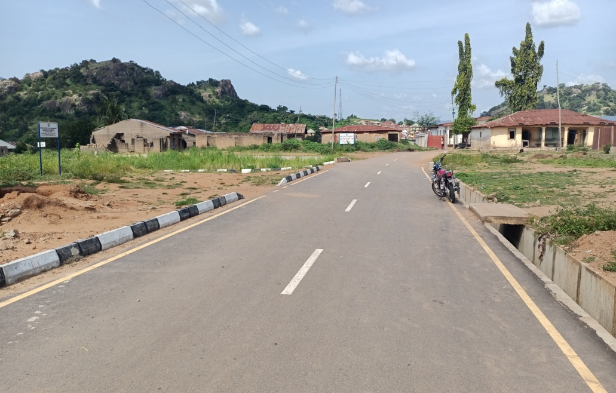
GULLY RECLAMATION AT OZURI, ADAVI LGA
These affected houses were compensated for and demolished during the civil works
GULLY HEAD/PALACE ROAD
BEFORE
BEFORE
AFTER

Slide 16
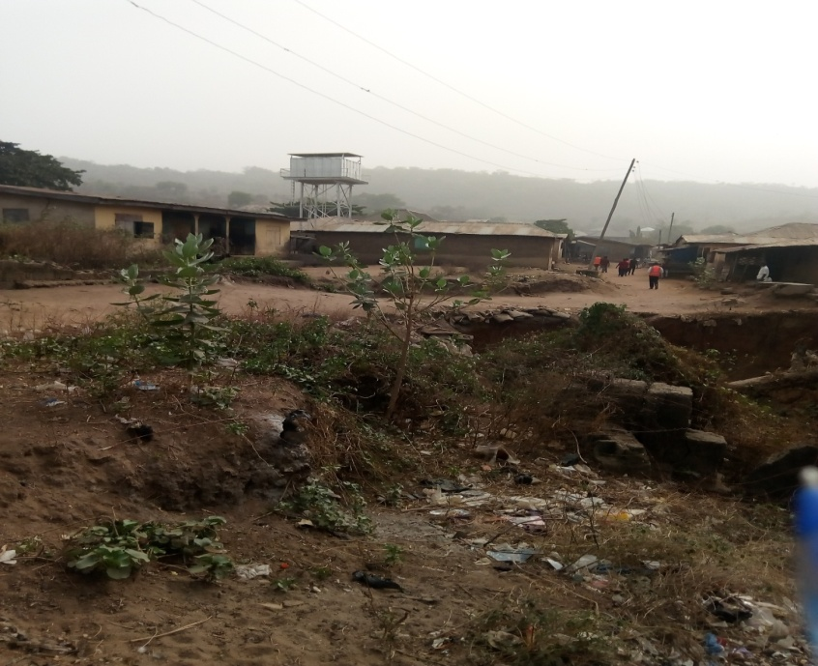
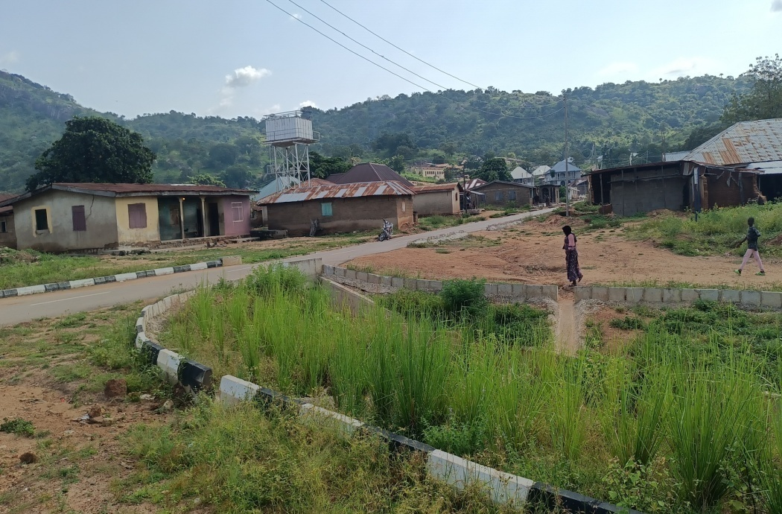
GULLY RECLAMATION AT OZURI, ADAVI LGA
GULLY HEAD/PALACE ROAD
BEFORE
AFTER

Slide 17
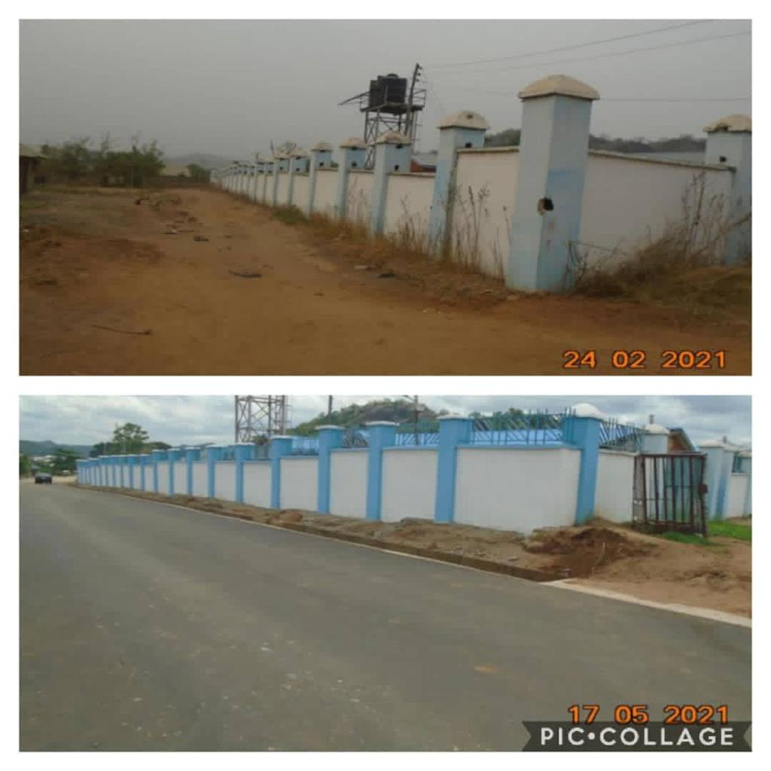
GULLY RECLAMATION AT OZURI, ADAVI LGA
Saved Hospital at Ozuri Gully Site
BEFORE
AFTER

Slide 18
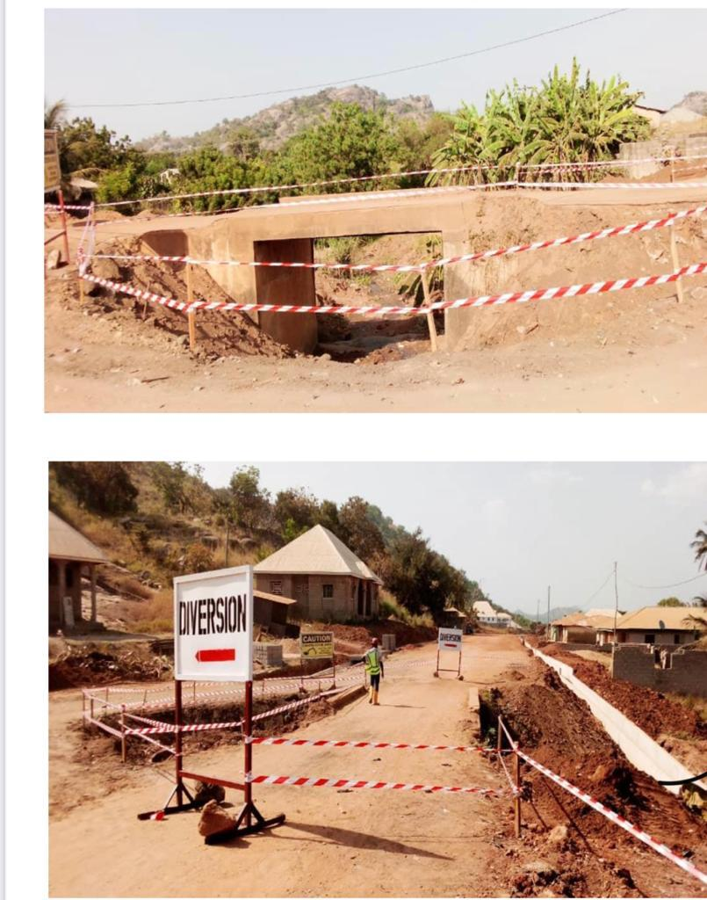
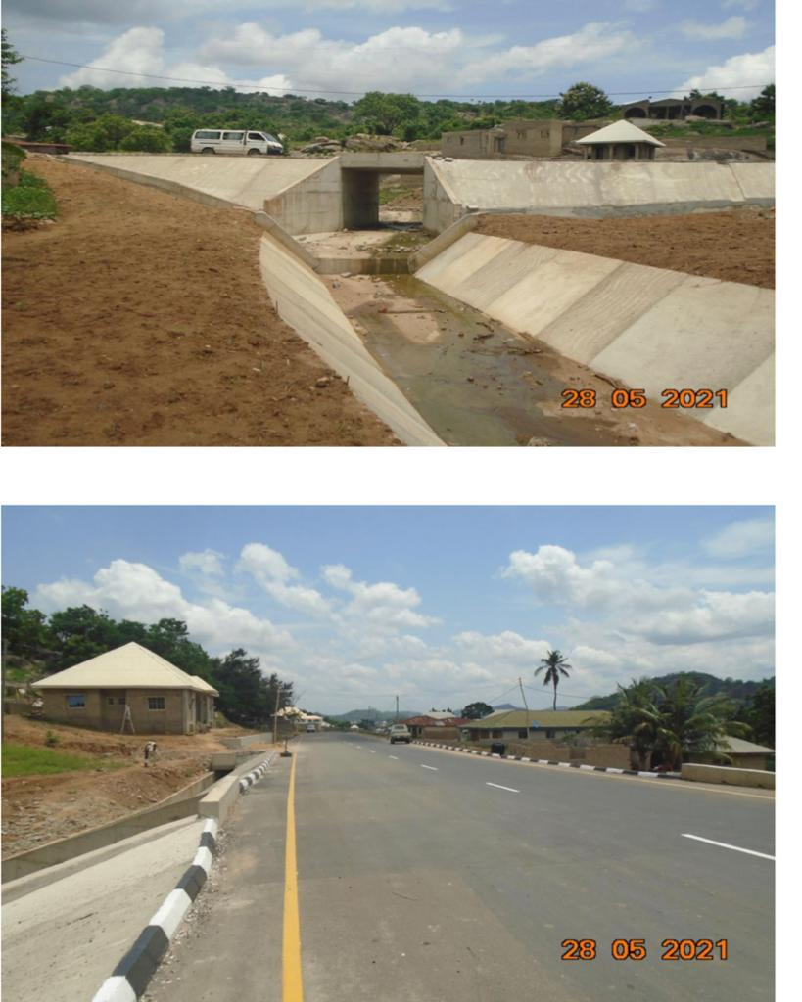
GULLY RECLAMATION AT OZURI, ADAVI LGA
Obangede Road
AFTER
BEFORE

Slide 19
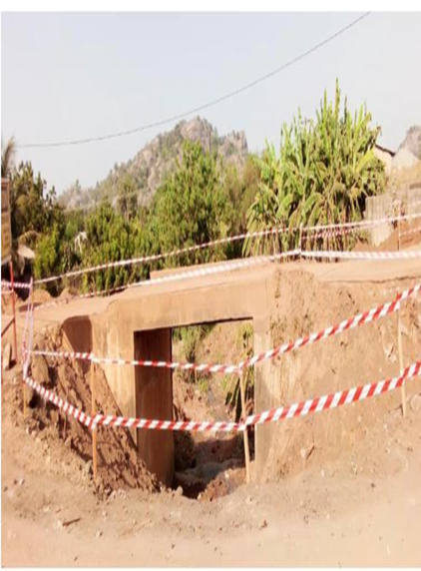
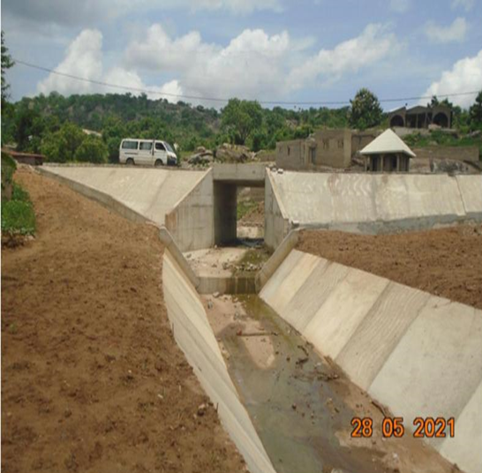
GULLY RECLAMATION AT OZURI, ADAVI LGA
OBANGEDE Road
BEFORE
AFTER

Slide 20
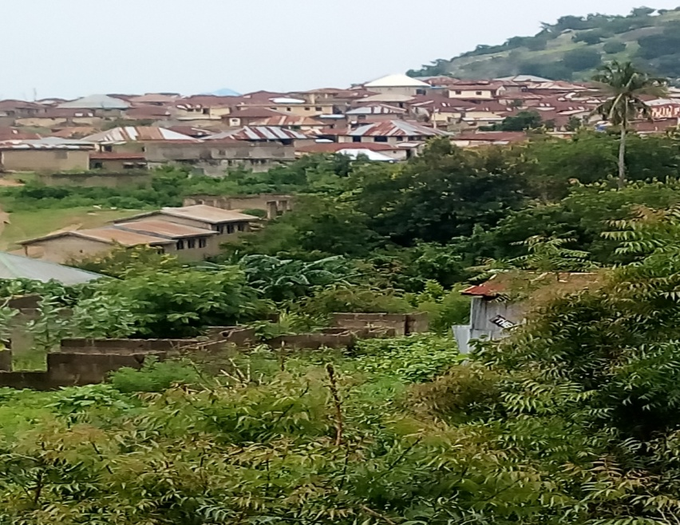
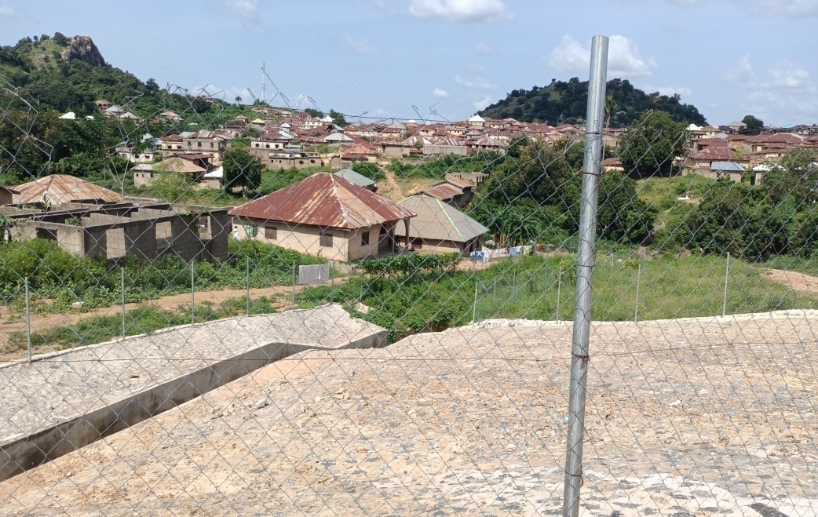
GULLY RECLAMATION AT OZURI, ADAVI LGA
The houses below were not visible and were inaccessible because of the gully below
BEFORE

Slide 21
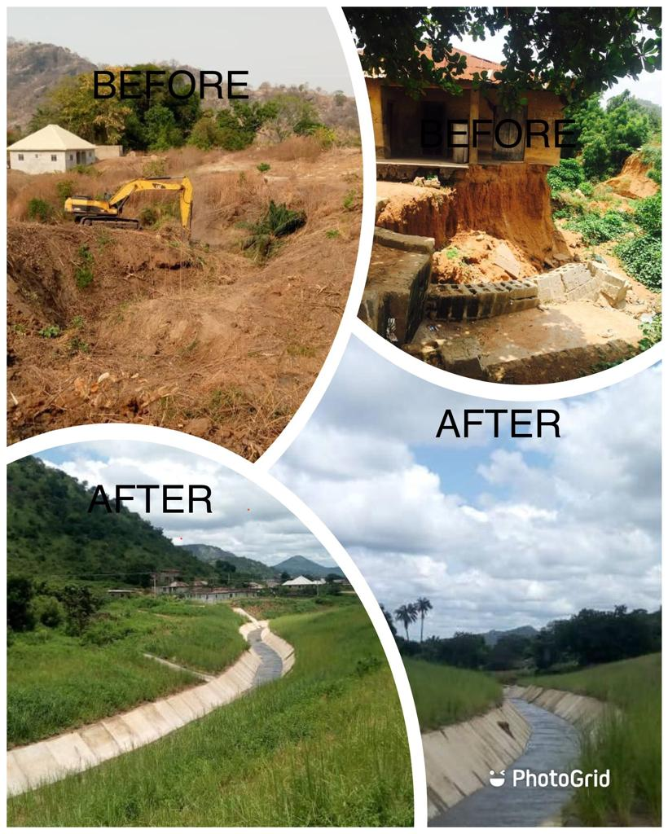
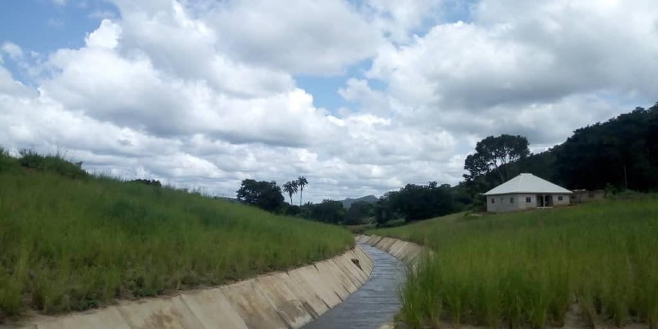
GULLY RECLAMATION AT OZURI, ADAVI LGA
BEFORE
AFTER

Slide 22
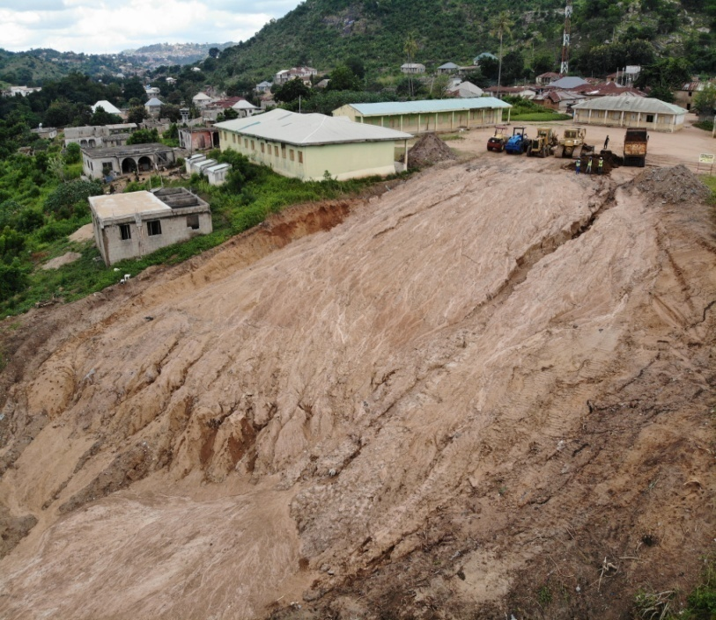
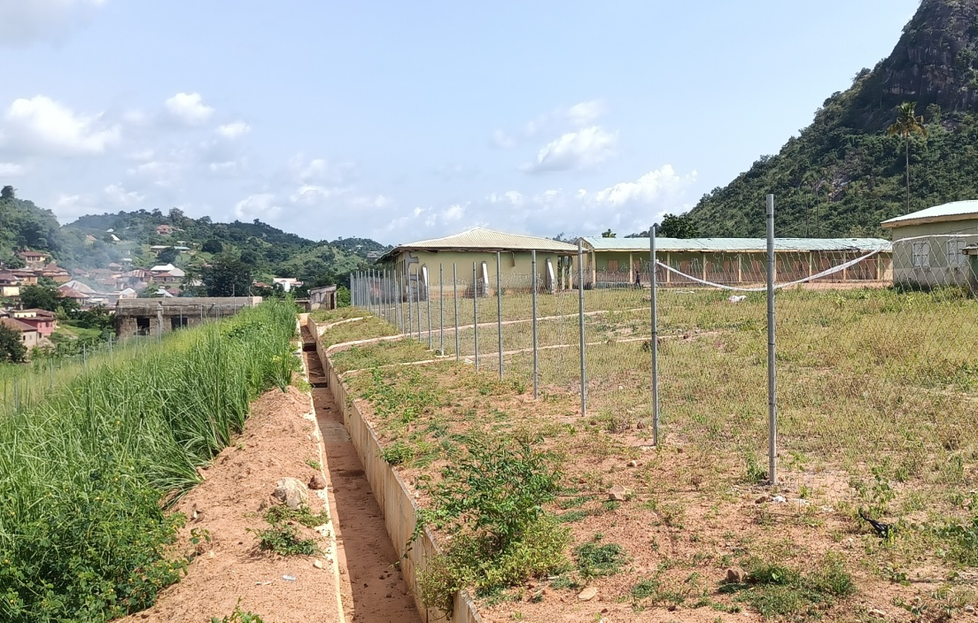
GULLY RECLAMATION AT OZURI, ADAVI LGA
LAND RECLAMATION AT LGEA PRIMARY SCHOOL
BEFORE
AFTER

Slide 23
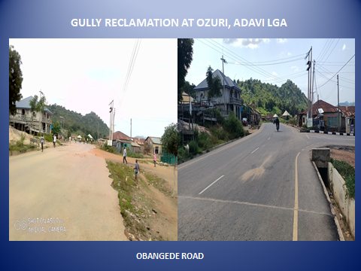
GULLY RECLAMATION AT OZURI, ADAVI LGA
OZURI MAIN ROAD
BEFORE
AFTER

Slide 24
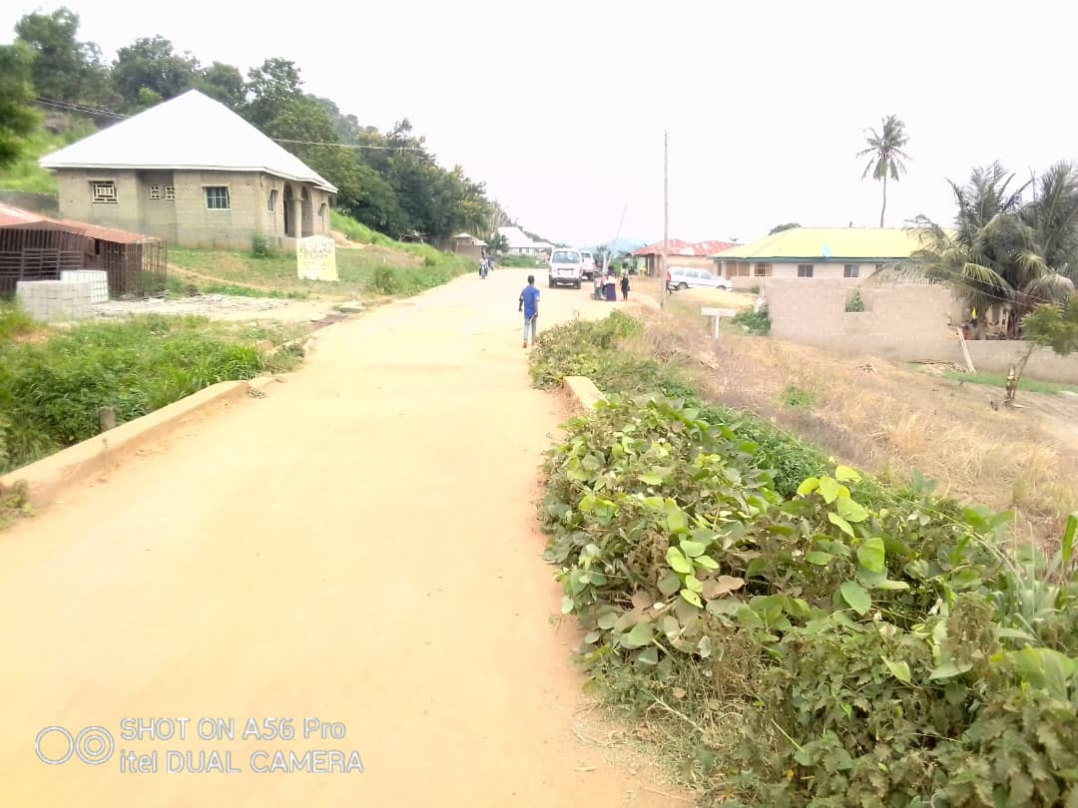
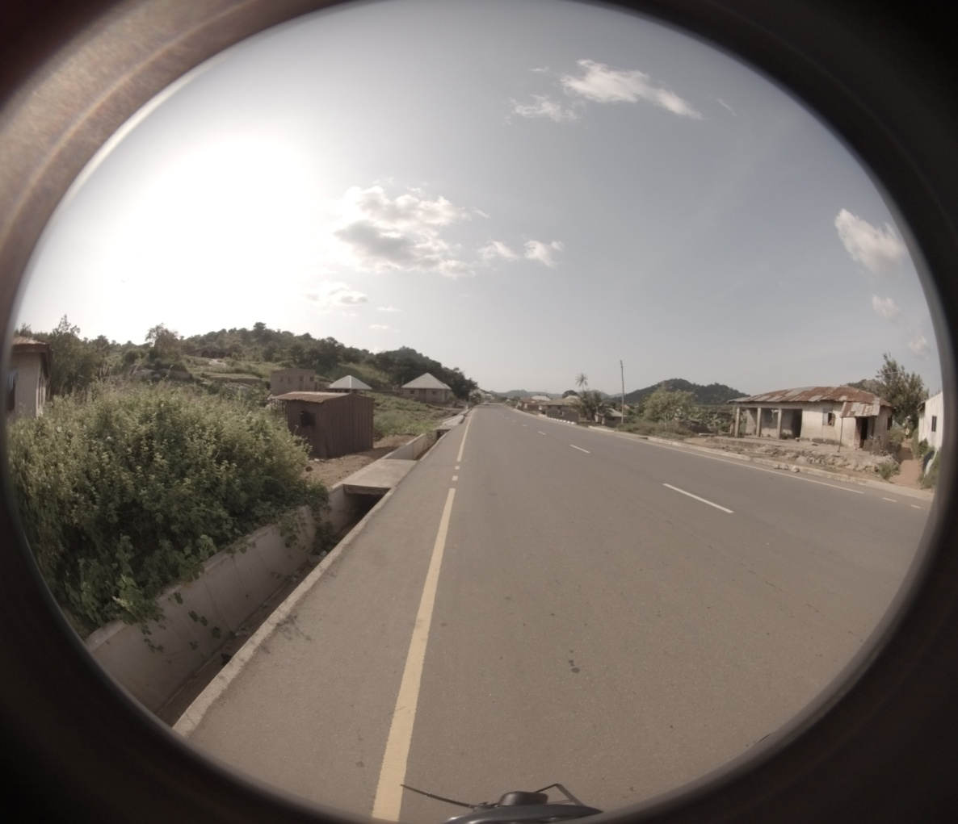
GULLY RECLAMATION AT OZURI, ADAVI LGAUSING 360 CAMERA TECHNOLOGY
OBANGEDE ROAD
BEFORE
AFTER

Slide 25


GULLY RECLAMATION AT OZURI, ADAVI LGA
OBANGEDE ROAD
BEFORE AFTER

Slide 26


GULLY RECLAMATION AT OZURI, ADAVI LGA
OGANGEDE ROAD
BEFORE AFTER

Slide 27

GULLY RECLAMATION AT OZURI, ADAVI LGA
OGANGEDE ROAD
BEFORE AFTER

Slide 28


GULLY RECLAMATION AT OZURI, ADAVI LGA
OGANGEDE ROAD
BEFORE AFTER

Slide 29


GULLY RECLAMATION AT OZURI, ADAVI LGA
OGANGEDE ROAD
BEFORE AFTER

Slide 30


GULLY RECLAMATION AT OZURI, ADAVI LGA
GULLY
BEFORE AFTER

Slide 31


GULLY RECLAMATION AT OZURI, ADAVI LGA
HOSPITAL ROAD
BEFORE AFTER

Slide 32


GULLY RECLAMATION AT OZURI, ADAVI LGA
HOSPITAL ROAD
BEFORE AFTER

Slide 33


GULLY RECLAMATION AT OZURI, ADAVI LGA
HOSPITAL ROAD
BEFORE AFTER

Slide 34


GULLY RECLAMATION AT OZURI, ADAVI LGA
HOSPITAL ROAD
BEFORE AFTER

Slide 35



Slide 36



Slide 37




Slide 38



Slide 39


GULLY RECLAMATION AT OZURI, ADAVI LGA
OBANGEDE ROAD
BEFORE AFTER

Slide 40
GULLY RECLAMATION AT OZURI, ADAVI LGA
BEFORE AFTER

Slide 41
GULLY RECLAMATION AT OZURI, ADAVI LGA

Slide 42
GULLY RECLAMATION AT OZURI, ADAVI LGA
USING 360 CAMERA TECHNOLOGY
OBANGEDE ROAD
BEFORE AFTER

Slide 43

GULLY RECLAMATION AT OZURI, ADAVI LGAUSING 360 CAMERA TECHNOLOGY
GULLY 0+400
BEFORE
AFTER

Slide 44


OGANE-AJI GULLY EROSION SITE, ANYIGBA
MAIN GULLY
The house with the red arrow was compensated for and demolished
BEFORE
AFTER

Slide 45


OGANE-AJI GULLY EROSION SITE, ANYIGBA
MAIN GULLY
BEFORE
ON GOING

Slide 46


OGANE-AJI GULLY EROSION SITE, ANYIGBA
AGALA ROAD
BEFORE
AFTER

Slide 47


OGANE-AJI GULLY EROSION SITE, ANYIGBA
GULLY 02 (OJOFU ROAD)
BEFORE
AFTER

Slide 48


OGANE-AJI GULLY EROSION SITE, ANYIGBA
OJOFU ROAD
BEFORE
AFTER

Slide 49


OGANE-AJI GULLY EROSION SITE, ANYIGBA
AGALA ROAD
BEFORE
AFTER

Slide 50


OGANE-AJI GULLY EROSION SITE, ANYIGBA
WATERWAY GULLY (AGALA ROAD)
BEFORE
ONGOING

Slide 51


GREATER LOKOJA WATER WORKS EROSION SITE
Devastating nature of the gully before intervention

Slide 52


GULLY RECLAMATION AT GREATER LOKOJA WATER WORKS, LOKOJA LGA
BEFORE
AFTER

Slide 53


GULLY RECLAMATION AT GREATER LOKOJA WATER WORKS, LOKOJA LGA
BEFORE
AFTER

Slide 54


GULLY RECLAMATION AT GREATER LOKOJA WATER WORKS, LOKOJA LGA
BEFORE
AFTER

Slide 55


GULLY RECLAMATION AT GREATER LOKOJA WATER WORKS, LOKOJA LGA
BEFORE
AFTER

Slide 56

GULLY RECLAMATION AT GREATER LOKOJA WATER WORKS, LOKOJA LGA
BEFORE
AFTER

Slide 57


GULLY RECLAMATION AT GREATER LOKOJA WATER WORKS, LOKOJA LGA
BEFORE
AFTER

Slide 58


ADUM ROAD GULLY EROSION SITE, OLAMABORO
Devastating nature of gully before intervention

Slide 59

Update on Civil Works… at Adum Road Gully Erosion Site
AERIAL VIEW OF ADUM ROAD, OGUGU EROSION SITE

Slide 60


Update on Civil Works… at Adum Road Gully Erosion Site
BEFORE…
ONGOING…

Slide 61


GULLY RECLAMATION AT ADUMU ROAD, OLAMABORO LGA
GULLY HEAD (PRIMARY SCHOOL OGUGU
BEFORE…
ONGOING…

Slide 62


ADUM ROAD GULLY EROSION SITE, OLAMABORO
BEFORE…
ONGOING…

Slide 63


ADUM ROAD GULLY EROSION SITE, OLAMABORO
BEFORE…
ONGOING…

Slide 64


ADUM ROAD GULLY EROSION SITE, OLAMABORO
BEFORE…
ONGOING…

Slide 65

ADUM ROAD GULLY EROSION SITE, OLAMABORO

Slide 66


ADUM ROAD GULLY EROSION SITE, OLAMABORO
BEFORE…
ONGOING…

Slide 67

COMPLETED AUTOMATIC WEATHER STATION AT KOGI STATE UNIVERSITY

Slide 68


COMPLETED AUTOMATIC WEATHER STATION AT KOGI STATE UNIVERSITY

Slide 69


COMPLETED AUTOMATIC WEATHER STATION AT KOGI STATE UNIVERSITY
INSTALLED EVAPORATION PAN AND SUNSHINE RECORDER

Slide 70


COMPLETED AUTOMATIC WEATHER STATION AT KOGI STATE UNIVERSITY
CUP COUNTER ANONEMETER AND WIND VANE

Slide 71


INSTALLED TELEMETRY EQUIPMENT AT BAGANA

